Slide 1

Android: Project Individu
Adi Yusuf
February 2022
Program ITDP

Slide 2
Introduction

Slide 3
Menu & Features
1
Menu
2
Features
Home
Intruktur
Materi
Peserta
Kelas
Detail Kelas
Cari Data
Insert
Update
Delete
Detail
Search

Slide 4
Home

Slide 5
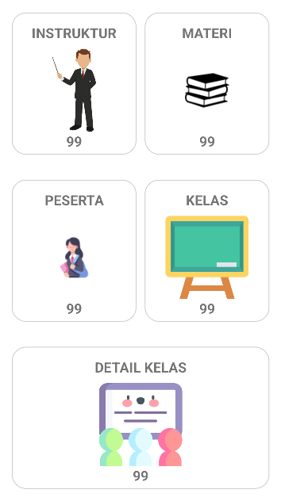

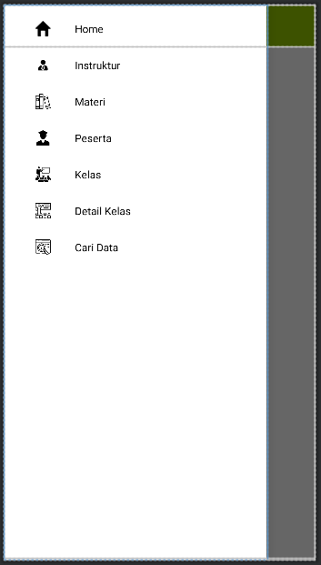
Home

Slide 6
Instruktur

Slide 7
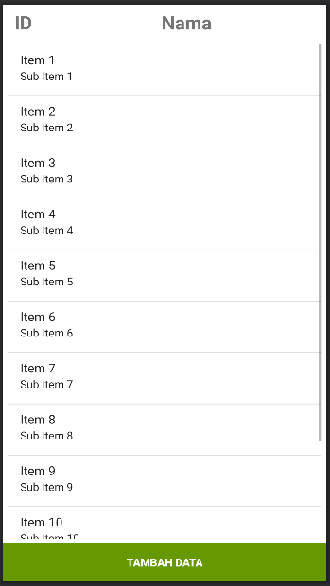
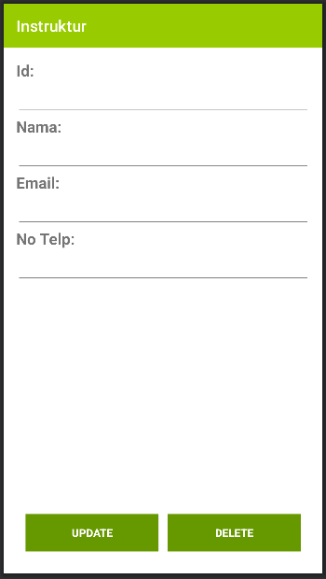
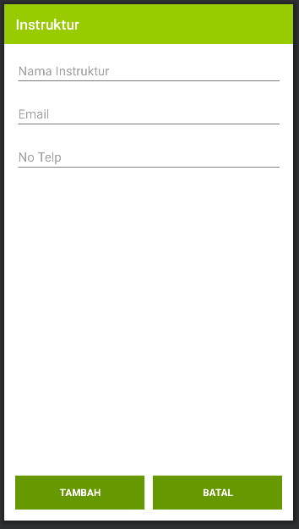
Instruktur

Slide 8
Materi

Slide 9
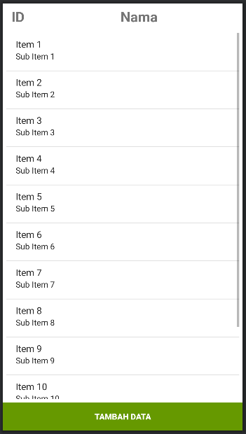
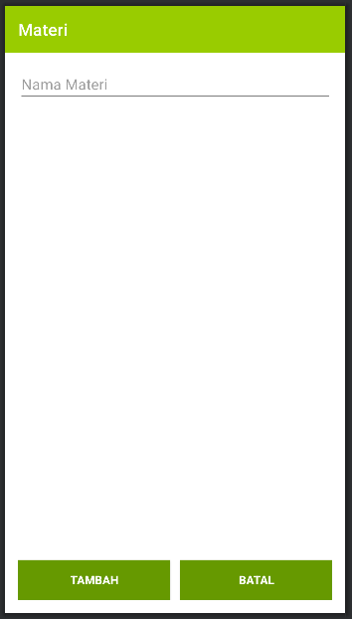
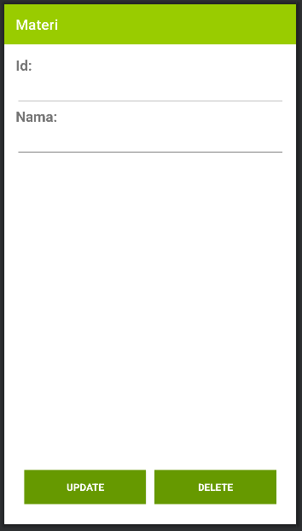
Materi

Slide 10
Peserta

Slide 11
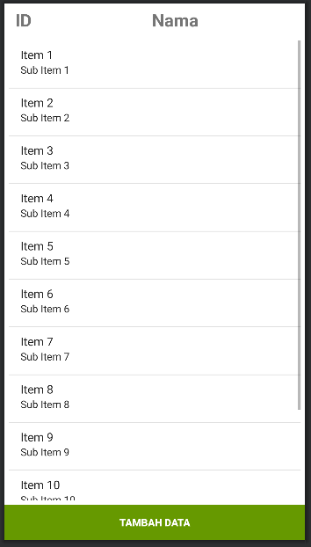
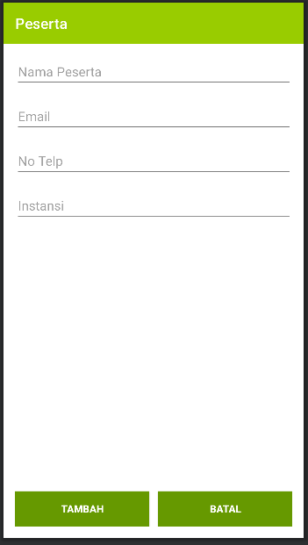
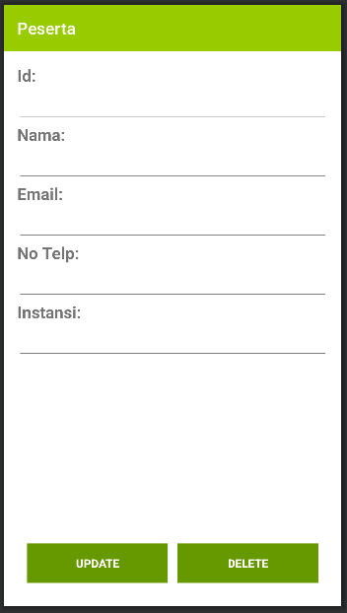
Peserta

Slide 12
Kelas

Slide 13
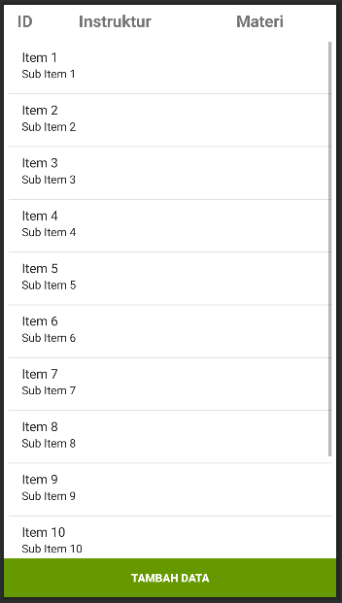
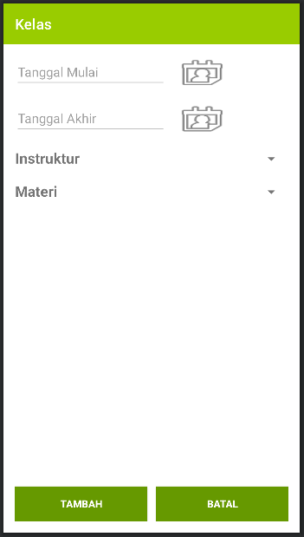
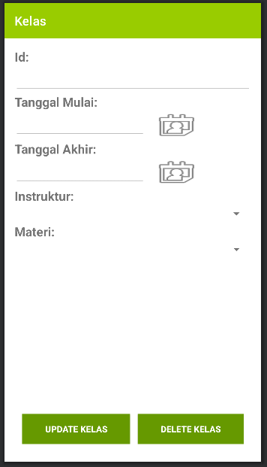
Kelas

Slide 14
Detail Kelas

Slide 15
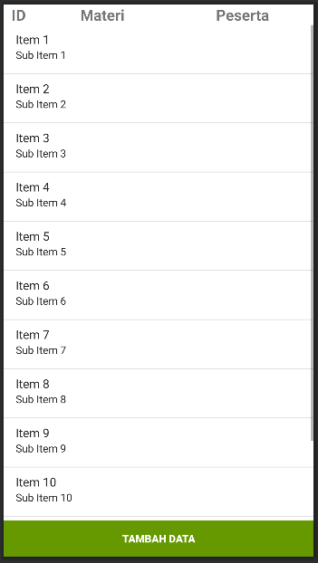
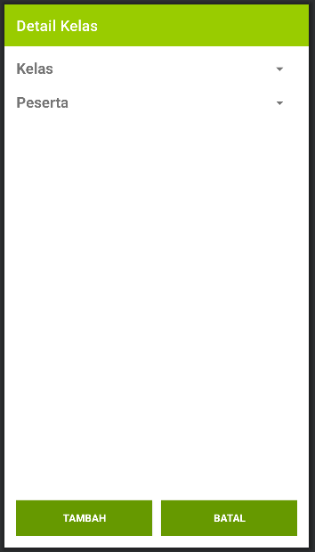
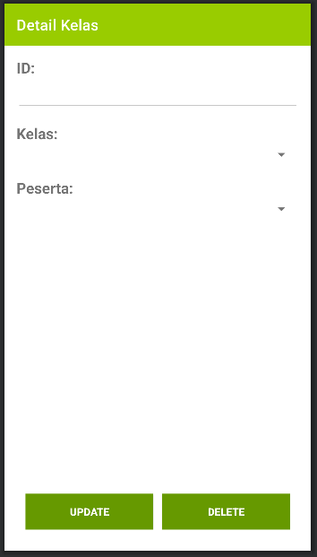
Detail Kelas

Slide 16
Cari Data

Slide 17
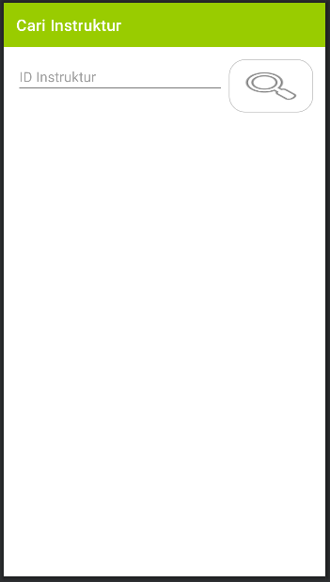
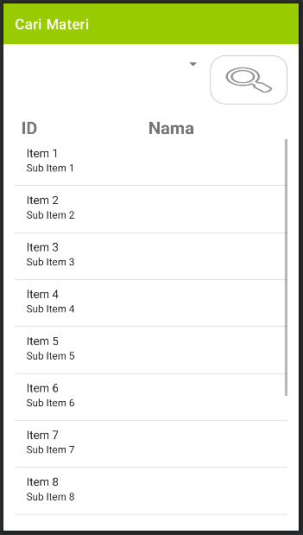
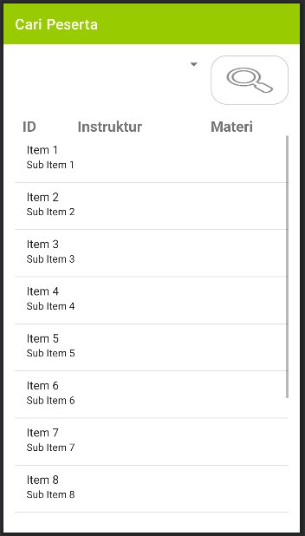
Cari Data

Slide 18
Demo Aplikasi

Slide 19
Terima Kasih

